Slide 1

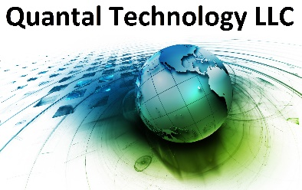
Emergent quantum technology and applications
David Farley
Quantal Technology

Slide 2


Quantum Truisms
Quantum technologies can potentially be better than classical
Quantum Computing & Software longest time horizon
Quantum Sensing & Encryption here now
Quantum states are fragile
Expertise and suppliers are few

Slide 3
Quantum Computing – Entangled “Qubits”
Qubit = “Quantum Bit” = atom with two states, or photon with two modes
Entangled qubits allow for massively parallel computing
Fundamental Problem: Environment quickly destroys entanglement
Secondary Problem: Expertise and supplies
Quantum Algorithms - using a quantum computer
Only a handful of quantum algorithms proven to enhance computing
Requires programmers who understand quantum
In the future, could enhance pharmaceutical development, etc.
Quantum Sensing – ultrasensitive measurements
Quantum states are fragile
Quantum sensing leverages quantum sensitivity to environmental perturbations
Opposite situation for quantum computing, where need to isolate from the environment
Quantum Encryption – Unbreakable (in theory)
Quantum Key Distribution (QKD) – relies on non-cloning of quantum wave functions
Shares random numbers between parties
Random numbers for One-Time Pad (OTP) encryption protocol (unbreakable)

Slide 4
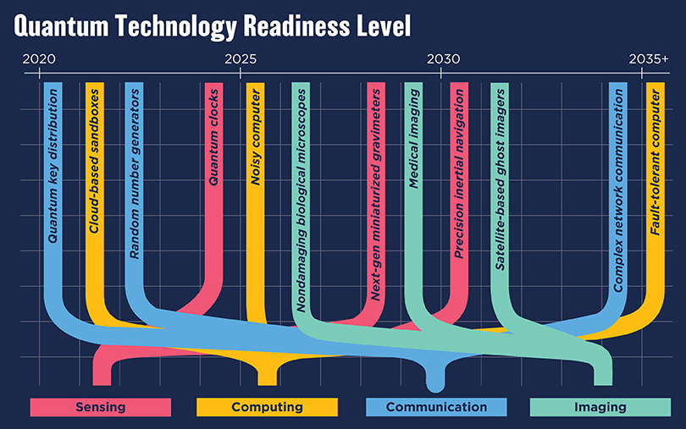

Slide 5
Basic Quantum Theory (“spooky physics”)
Put a “state” into a “ket”: |vertical polarization> =
Now make a “superposition” of pure states:
This wave function is in both the horizontal and vertical states, until measured
Now consider two “entangled” particles (photons):
There is no way to factor out vertical or horizontal states
Quantum computers seek to leverage the entanglement of many particles

Slide 6
“Qubit” versus “Bit”
A classical computer uses “bits”, which are either a “zero” (0 Volts) or a “one” (5 Volts)
In quantum, we have the “qubit”, which is both a “zero” and a “one”
Until we measure it
We can entangle two (or more) qubits:
This is the idea of a quantum computer
Quantum Advantage Example: Li-3
To simulate the electron wave function for Lithium (N=3 electrons) using a computational grid divided into 3m regions requires a classical computer able to store 2^{3mN} amplitudes. To achieve a precision of 10% requires m=3, so 2²⁷ bytes needed (500 petabytes!). A quantum computer needs just 27 entangled qubits.

Slide 7
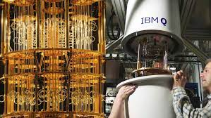
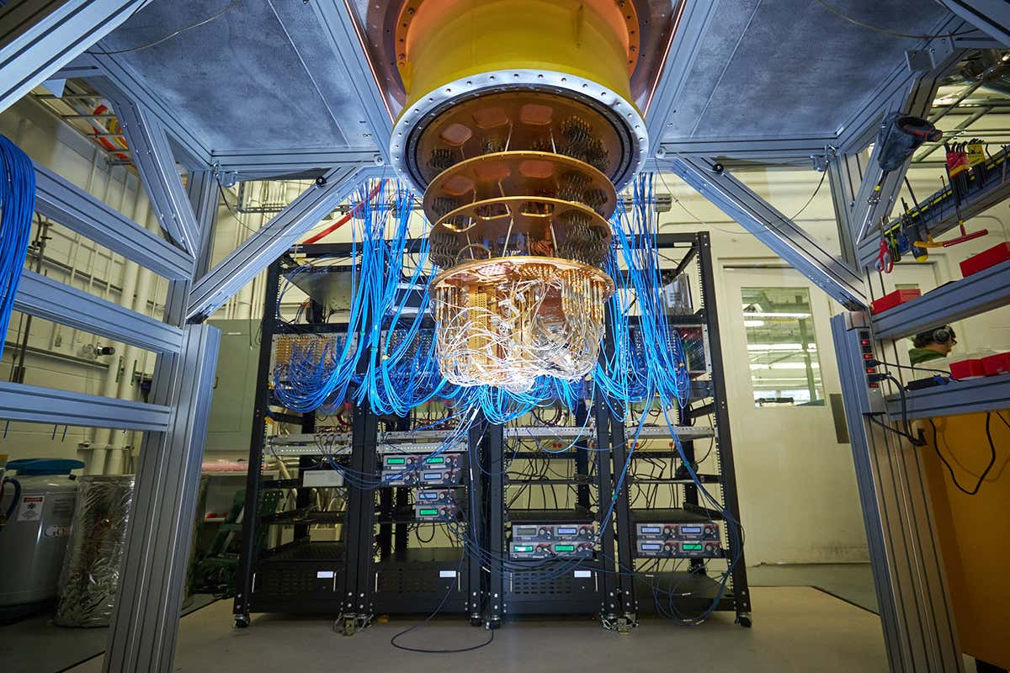
Quantum Computing
IBM
Google
Different Approaches:
Superconducting qubits (pics)
Trapped Ions
Quantum dots
Photons
Others

Slide 8
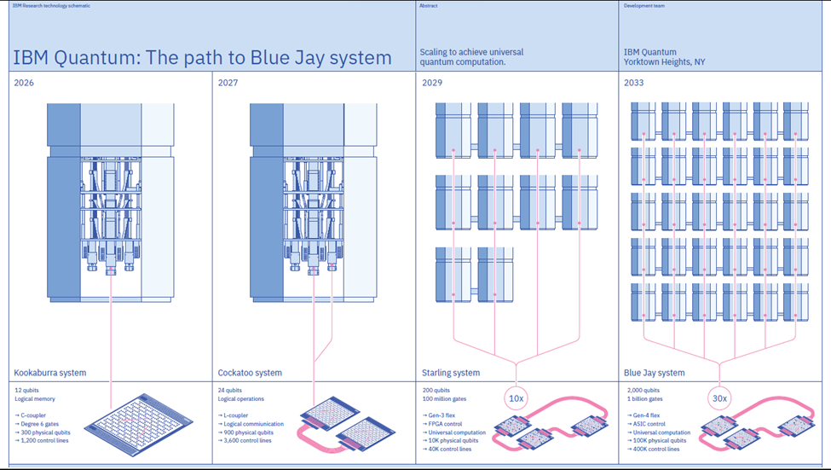
“FPGA control”

Slide 9
Quantum Algorithms
Quantum computers are useless without quantum algorithms (software):
Currently requires expert knowledge in quantum mechanics and applications
Only a handful of algorithms have been developed that would make a QC better than a classical computer
Shor’s Algorithm (breaks public-key encryption)
Grover’s Algorithm (sort a large database faster)

Slide 10
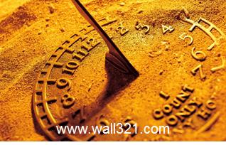
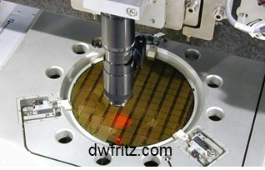
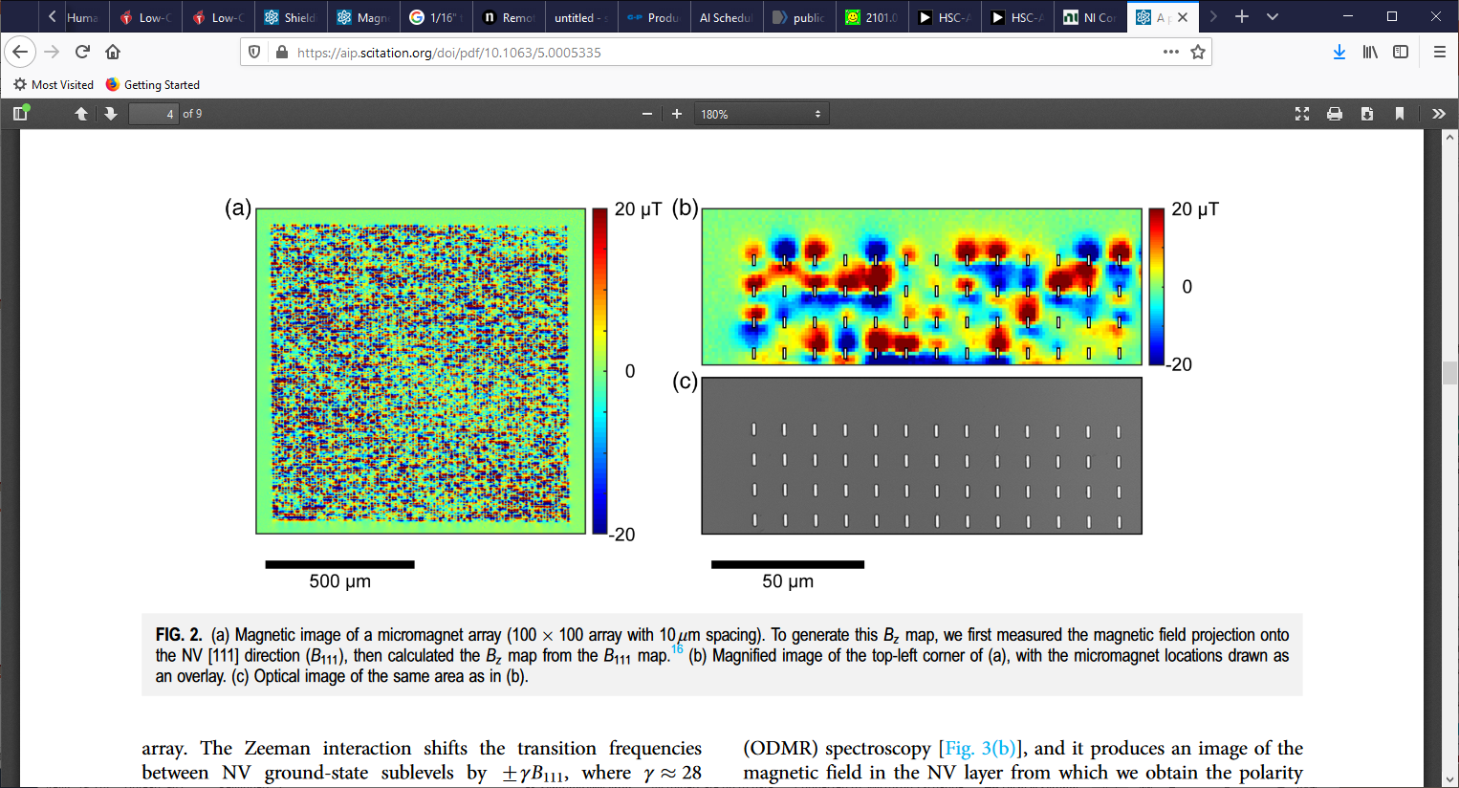
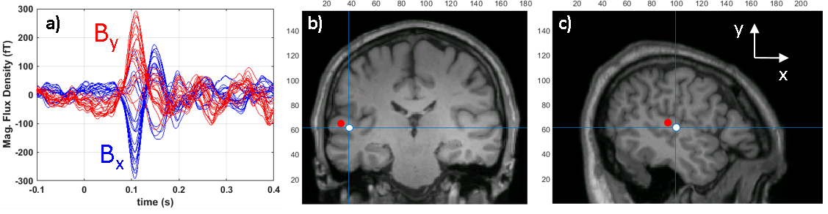
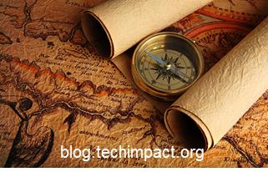
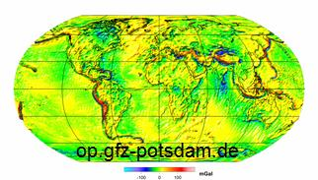
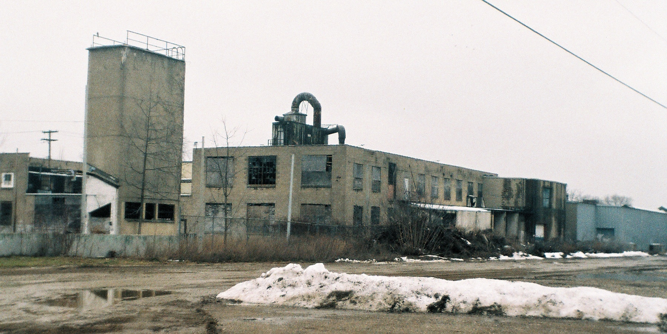
Timing
Non Destructive Evaluation
Surface Science
QUANTUM
SENSORS
Navigation
Medical Imaging
Trace Chemical
Detection
Gravimetry

Slide 11
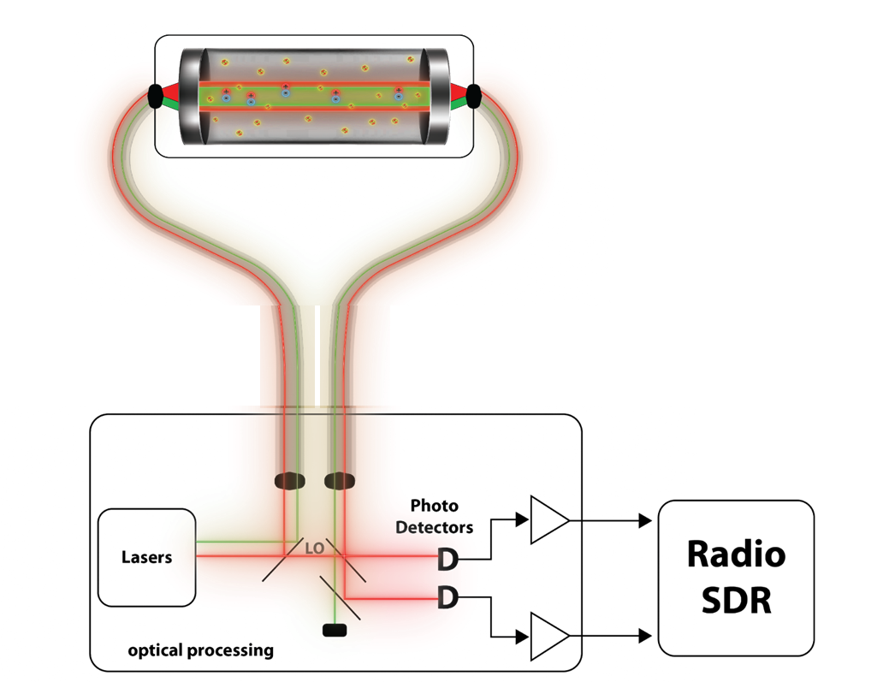
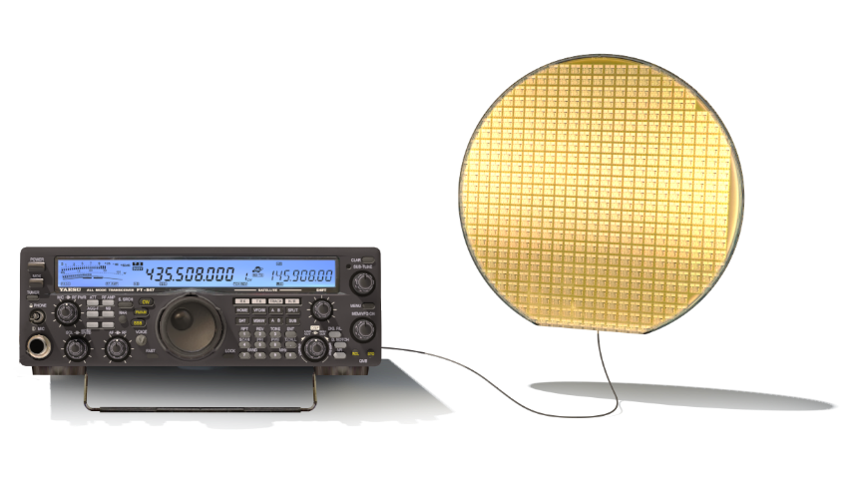
Quantum “Antenna” or Aperture
Established circa 2010
DARPA Envisioned Program End State
ARL
Atom-bound electrons in a vapor cell monitor RF amplitude subject to laser controls. Shape is not relevant.
Photonic processing
Receive only without inherent “gain”
Different Physics and Different Limits = Large Opportunity
DARPA Quantum Apertures Program

Slide 12
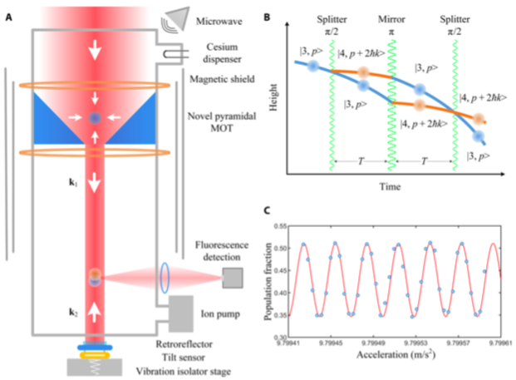
Atom Interferometry (“Quantum Gravity Sensor”)

Slide 13
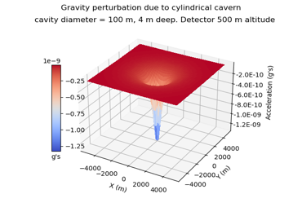
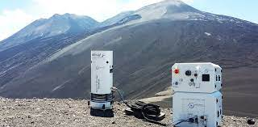
Detect Underground Structures
Quantum Gravimetry
Gravimetric signatures are always present as mass cannot be shielded
Gravimetric methods based on atom interferometry may offer a solution for rapid, sensitive detection of buried structures
500m (100m)
Altitude
Cavity
4m
Muquans Instrument
100m (20m) Diameter

Slide 14
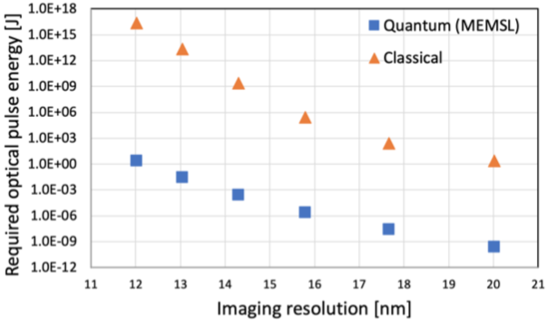
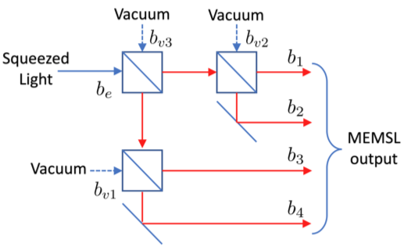
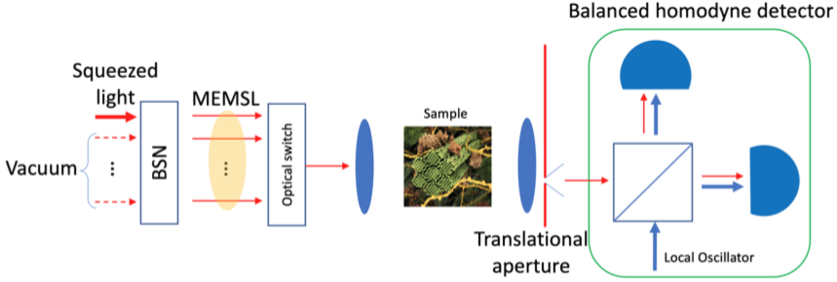
Quantum Imaging using Massively Entangled Multimode Squeezed Light (MEMSL)
Calculated required optical pulse energy vs. desired imaging resolution
Generation of a MEMSL source using a Beam Splitter Network

Slide 15
Quantum “Ghost” imaging
Entangled photon source
Target
Image of target
in other spectral region

Slide 16
Quantum Key Distribution (QKD) – “Quantum Encryption”
Secure because can detect Eavesdropper ”Eve”, who disrupts the quantum state
China’s Micius satellite sets distance record for quantum entanglement in space
Part of ambitious Chinese program: Quantum Experiments at Space Scale (QUESS; Chinese: 量子科学实验卫星)

Slide 17
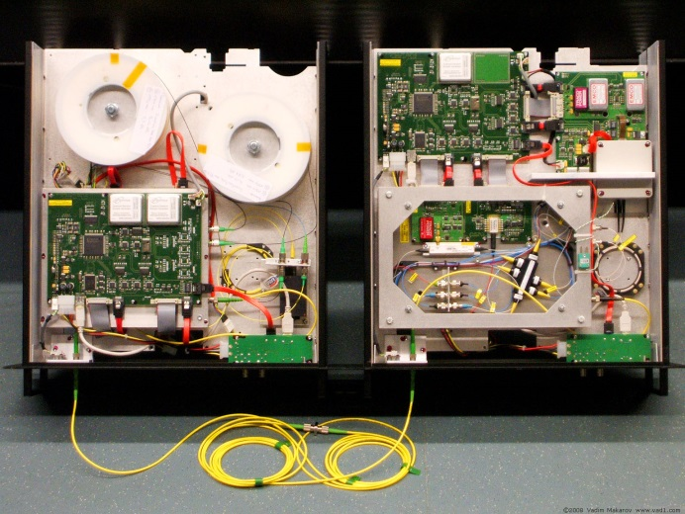
QKD requires hardware unlike Public Keys, but significant software processing needed
Unlike current data encryptions standards, which are software-based (e.g. RSA, AES, SHA), QKD relies on hardware:
Lasers (single photon or traditional laser)
Detectors (single photon or homodyne)
Fiber optics
High-speed modulators
Trend is to put all components on a photonic chip
ID Quantique Clavis QKD System (Swiss)

Slide 18
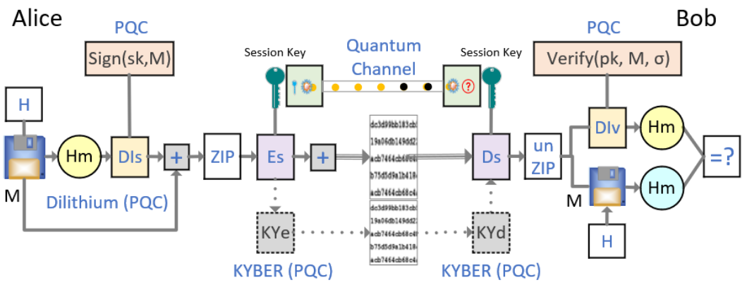
Quantum Good Privacy at Morgan State University
QGP Authentication Protocol Diagram. M: Message, H: Hash Functions (SHA 2/3), Hm: Hashed
message, Dis/Div: Dilithius Sign/Verify (PQC), ZIP/unZIP: Compression/Decompression, Es/Ds: Symmetric Key Encryption/Decroption, KYe/KYd: KYBER Encryption/Decryption (PQC)

Slide 19
Quantum Courses Progression
Core 1-year Requirement
QM for CS
QM Lab 1
Intro to QIS
QM Lab 2
Quantum Computing Pipeline
Applied Quantum Pipeline
Intro to QC
Quantum Crypto
QKD Lab
Applied QC
Quantum Sensing
Q-Sensing Lab
Quantum Algos
FPGA Intro
FPGA Lab I
Quantum ML
Applied FPGA
FPGA Lab II

Slide 20
Extras

